Slide 1


Marco Travaglini
April 8, 2022

Slide 2

Executive Summary
We will predict if the SpaceX Falcon 9 first stage rocket launches will land successfully.
The reason for doing so is that SpaceX has a much lower cost than other traditional providers of rocket payload transport and this low cost is very heavily based on the ability to land and re-use rockets. Therefore, if we can determine if the rocket will land successfully, we can determine the cost of a launch.
Methodology
To do this, we use past SpaceX data and machine learning models to make the predictions. We will use 4 different models and select the best one.
Logistic Regression
Decision Tree
Support Vector Machine
K Nearest Neighbour
Summary
All the models performed similarly, and we can predict a successful launch with 83% accuracy.

Slide 3
Introduction
Space travel has advanced tremendously over the last several years. Companies like Virgin Galactic, Blue Origin and SpaceX are making space travel affordable in the areas of sub-orbital space flights, launching small satellites, establishing a low-orbit internet satellite grids and providing transportation to and from the International Space Station.
This project focuses on SpaceX and their reusable Falcon 9 first-stage rocket landing success rate. The success of SpaceX hinges on their relatively inexpensive rocket launches. The cost of the launches is hugely impacted by whether the landing of the reusable rocket is successful or not.
We will analyze the various rocket launch data attributes to predict whether the Falcon 9 first stage landing will be successful or not.

Slide 4

Section 1

Slide 5
Methodology
Executive Summary
Data collection methodology:
Describe how data was collected
Perform data wrangling
Describe how data was processed
Perform exploratory data analysis (EDA) using visualization and SQL
Perform interactive visual analytics using Folium and Plotly Dash
Perform predictive analysis using classification models
How to build, tune, evaluate classification models

Slide 6
Data Collection – SpaceX API
The first method used for data collection is the SpaceX Open Source REST API described by
https://github.com/r-spacex/SpaceX-API
The main launch data for all past SpaceX launches is retrieved from the REST API endpoint
https://api.spacexdata.com/v4/launches/past
(To make the requested JSON results more consistent, we will use the following static response object for this project:
https://cf-courses-data.s3.us.cloud-object-storage.appdomain.cloud/IBM-DS0321EN-SkillsNetwork/datasets/API_call_spacex_api.json)
We use the Python requests library to access the https API endpoints. This returns the data in JSON format, which we store as a variable using Python json() method and then convert it to a Pandas dataframe using the Pandas json_normalize() method.

Slide 7
Data Collection – SpaceX API – cont’d
Most of the required data is now stored in the dataframe, however, many of the attributes are returned as IDs. For example, the rocket column has no information about the rocket but just an identification number.
We use the API again to get information about the launches using the IDs given for each launch. Specifically, we use columns rocket, payloads, launchpad, and cores which are all IDs to retrieve more information from the following API’s:
https://api.spacexdata.com/v4/rockets/
https://api.spacexdata.com/v4/payloads/
https://api.spacexdata.com/v4/launchpads/
https://api.spacexdata.com/v4/cores/

Slide 8
Data Collection – SpaceX API – cont’d
We defined a function for each of the above to retrieve the respective information for each row of the dataframe and store in a list. We then create a dictionary using the information we want from the current “data” dataframe, and from the lists of data retrieved from the other function API calls:
launch_dict = {'FlightNumber': list(data['flight_number']),
'Date': list(data['date']),
'BoosterVersion':BoosterVersion,
'PayloadMass':PayloadMass,
'Orbit':Orbit,
'LaunchSite':LaunchSite,
'Outcome':Outcome,
'Flights':Flights,
'GridFins':GridFins,
'Reused':Reused,
'Legs':Legs,
'LandingPad':LandingPad,
'Block':Block,
'ReusedCount':ReusedCount,
'Serial':Serial,
'Longitude': Longitude,
'Latitude': Latitude}
A new “data” dataframe is then created from this dictionary using the command:
data = pd.DataFrame.from_dict(launch_dict)

Slide 9
Data Collection – SpaceX API – cont’d
GIT URL
https://github.com/mtravaglini/DataScienceCapstone/blob/master/jupyter-labs-spacex-data-collection-api.ipynb

Slide 10
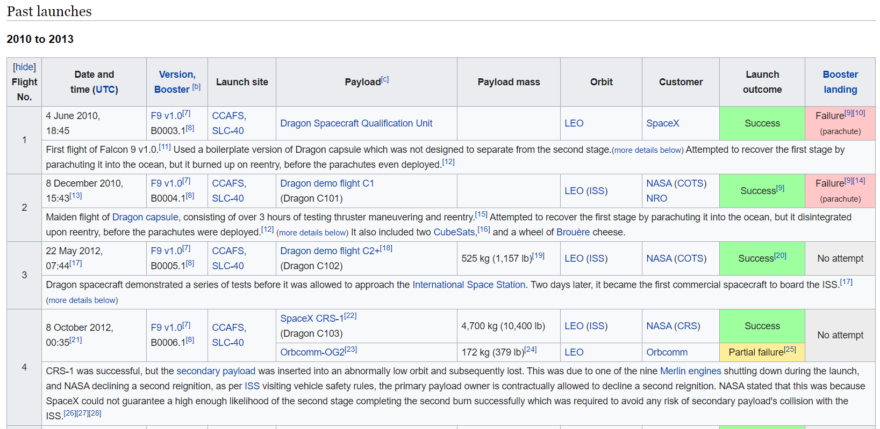
Data Collection - Scraping
We also use web scraping to collect additional SpaceX launch data. The Python requests library is used to access :
https://en.wikipedia.org/w/index.php?title=List_of_Falcon_9_and_Falcon_Heavy_launches&oldid=1027686922
The BeautifulSoup library is used to store the resulting data as an html object. The data that we are interested in on the webpage is the html table of past launches, shown here:

Slide 11
Data Collection – Scraping – cont’d
We use the find_all("table") method on the html object to access all the tables. From there, we access the specific table we want and then access all the <th> (i.e., table header) elements from the table to use as the column names:
['Flight No.', 'Date and time ( )', 'Launch site', 'Payload', 'Payload mass', 'Orbit', 'Customer', 'Launch outcome’]
From here, we access all the <tr> (i.e., table row) elements from the table, and store the data in a Python list for each column. These lists are themselves all stored in a Python dictionary object. Once all the data is scraped, the dictionary is converted to a Pandas dataframe.

Slide 12
Data Collection – Scraping – cont’d
GIT URL
https://github.com/mtravaglini/DataScienceCapstone/blob/master/jupyter-labs-webscraping.ipynb

Slide 13
Data Wrangling
There were several different aspects to the data wrangling component of this project. Some of the wrangling is necessarily mixed in with the Data Collection steps. For example, when acquiring data via the SpaceX API, the data needed to be transformed into the structure and formats suitable for the analysis we want to perform.
The updates made were:
discard unneeded columns that were returned by the API, so keep only the required columns as follows
data = data[['rocket', 'payloads', 'launchpad', 'cores', 'flight_number', 'date_utc’]]
remove rows with multiple cores because those are falcon rockets with 2 extra rocket boosters
remove rows that have multiple payloads in a single rocket
data = data[data['cores'].map(len)==1]
data = data[data['payloads'].map(len)==1]
change ‘payloads’ and ‘cores’ columns from single-value lists to text values
data['cores'] = data['cores'].map(lambda x : x[0])
data['payloads'] = data['payloads'].map(lambda x : x[0])
convert ‘date_utc’ to a datetime datatype, keeping only the date portion and discarding the time
data['date'] = pd.to_datetime(data['date_utc']).dt.date
keep only the rows with a date <= November 13, 2020
data = data[data['date'] <= datetime.date(2020, 11, 13)]
keep only Falcon 9 launches
data_falcon9 = data[data['BoosterVersion']=='Falcon 9']

Slide 14
Data Wrangling - cont’d
Next the data was checked for any missing/null values. We used the following command to check:
data_falcon9.isnull().sum()
FlightNumber 0
PayloadMass 5
LandingPad 26
Orbit 0
… etc.
This showed that the ‘PayloadMass’ and ‘LandingPad’ columns had several missing values. For ‘LandingPad’, we can leave this as is, since the value None just means there was no landing pad used for that launch. For ‘PayloadMass’, we decide to replace the missing values with the mean of that column. This is done as follows:
PayloadMassMean = data_falcon9['PayloadMass'].mean()
data_falcon9['PayloadMass'] = data_falcon9['PayloadMass'].replace(np.nan, PayloadMassMean)

Slide 15
Data Wrangling - cont’d
Part of Data Wrangling involves data discovery to gain an understanding of what the data means. For example, the ‘Outcome’ column has values such as:
True Ocean means the mission outcome was successfully landed to a specific region of the ocean
False Ocean means the mission outcome was unsuccessfully landed to a specific region of the ocean
True RTLS means the mission outcome was successfully landed to a ground pad
etc.
We want to change this to values of ‘0’ for failed landings and ‘1’ for successful landings. First, we determine all the failed landing values of the ‘Outcome’ column and save them in a set:
for i,outcome in enumerate(landing_outcomes.keys()):
print(i,outcome)
0 True ASDS
1 None None
2 True RTLS
3 False ASDS
4 True Ocean
5 None ASDS
6 False Ocean
7 False RTLS
bad_outcomes=set(landing_outcomes.keys()[[1,3,5,6,7]])

Slide 16
Data Wrangling - cont’d
Once we’ve done that, we can use the set to add a ‘Class’ column to the dataframe:
landing_class = list(df['Outcome'].isin(bad_outcomes).replace({True: 0, False: 1}))
df['Class']=landing_class
df[['Class','Outcome']].head(8)
Class Outcome
0 None None
0 None None
0 None None
0 False Ocean
0 None None
0 None None
1 True Ocean
1 True Ocean
Now we have a Boolean column indicating successful/failed landings.

Slide 17
Data Wrangling – cont’d
GIT URL
https://github.com/mtravaglini/DataScienceCapstone/blob/master/jupyter-labs-spacex-data-collection-api.ipynb
https://github.com/mtravaglini/DataScienceCapstone/blob/master/labs-jupyter-spacex-Data%20wrangling.ipynb

Slide 18
EDA with Data Visualization
The first chart plotted is FlightNumber vs. PayloadMass. We can see how the flight number (indicating the continuous launch attempts) and the payload mass affect the outcome (i.e., Class column) of the launch.
The next chart plotted is FlightNumber vs. LaunchSite to see if the launch site had any effect on the success rate. We can easily get the success percent by launch site as follows:
df.groupby(by=['LaunchSite'])['Class'].mean() * 100
LaunchSite
CCAFS SLC 40 60.000000
KSC LC 39A 77.272727
VAFB SLC 4E 76.923077
The next chart plotted is PayloadMass vs. LaunchSite to see if there is any relationship between the two.
Next is a bar chart showing the percentage of successful launches by Orbit. We can calculate this with:
df.groupby(by=['Orbit'])['Class'].mean() * 100
Orbit
ES-L1 100.000000
GEO 100.000000
GTO 51.851852
HEO 100.000000
etc.

Slide 19
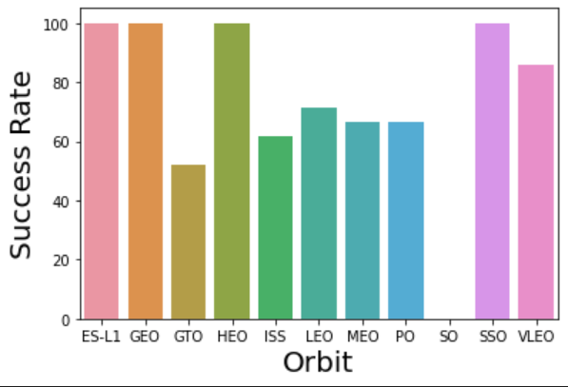
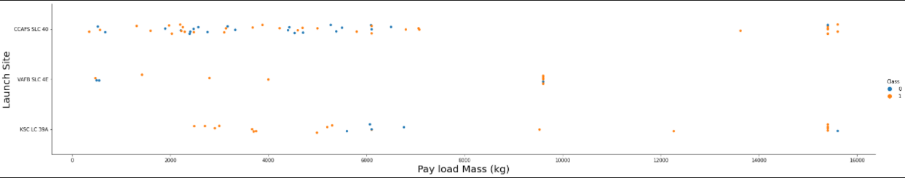
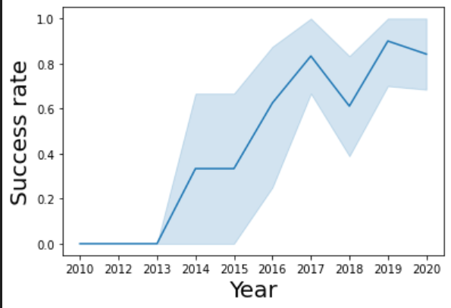
EDA with Data Visualization – cont’d
Other charts created were:
a scatter plot showing the relationship between FlightNumber and Orbit type
a scatter plot showing the relationship between PayloadMass and Orbit type
yearly trend line chart of the launch success rate
Using various types of charts showing the dataset features and outcomes, some relationships become obvious and those features that are important in determining the launch outcome can be discovered.
This information is easier to discover visually than poring through the raw data.

Slide 20
EDA with Data Visualization – cont’d
GIT URL
https://github.com/mtravaglini/DataScienceCapstone/blob/master/jupyter-labs-eda-dataviz.ipynb

Slide 21
EDA with SQL
Following is a summary of the Exploratory Data Analysis queries that were performed.
List the unique launch sites names.
List 5 rows with launch site names that begin with CCA.
Return the total payload mass carried by boosters launched by NASA (CRS).
Return the average payload mass carried by booster version F9 v1.1.
Return the date when the first successful landing outcome in ground pad was achieved.
List the booster names with success in drone ship landings and payload mass greater than 4000 but less than 6000 kg.
List the total number of successful and failure mission outcomes.
List the names of the booster versions which have carried the maximum payload mass.
List the failed landing outcomes in drone ship, their booster versions, and launch site names for the year 2015.
List the count of all landing outcomes between the date 2010-06-04 and 2017-03-20, in descending order
These queries will allow further analysis on how the features/independent variables are related to launch outcomes.

Slide 22
EDA with SQL – cont’d
GIT URL
https://github.com/mtravaglini/DataScienceCapstone/blob/master/jupyter-labs-eda-sql-coursera.ipynb

Slide 23
Build an Interactive Map with Folium
Mapping with Folium allows us to do more interactive visual analysis of the launch data. To do this, we need to update the map with launch information.
We use markers to mark the names of all the launch sites on the map itself. We also add circles around each launch site, so they are easy to see on the map. The circles have a pop-up that also show the name of the launch site when the they are clicked.
We also add marker clusters to group markers at each launch site. The markers show successful (green) or failed (red) launches.
We’ve also added lines to the map to show distances from significant landmarks that could also influence the location of the launch sites.
We add the various markers, circles and lines to help find some geographical patterns about launch sites and success rates.

Slide 24
Build an Interactive Map with Folium – cont’d
GIT URL
https://github.com/mtravaglini/DataScienceCapstone/blob/master/lab_jupyter_launch_site_location.ipynb

Slide 25
Build a Dashboard with Plotly Dash
Using Plotly, we’ve built a dashboard with two graphs. The first is a pie chart with a drop-down list to select the launch site. If All Sites is selected, the chart shows all the launch sites with each slice indicating the percentage of successful launches from that site.
If a specific site is selected from the drop-down list, the chart shows the percentage of successful and failed launches for that site.
The second graph in the dashboard is a scatter plot showing the relationship between payload mass and successful launches broken down by booster version category. The same drop-down list can be used to show all the launch sites or to select a specific site. There is also a range slider to limit the display to those payloads that fall within the selected range on the slider.

Slide 26
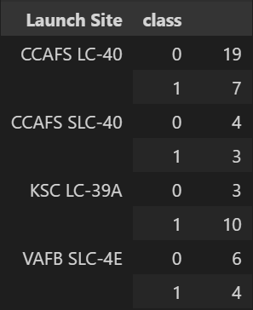
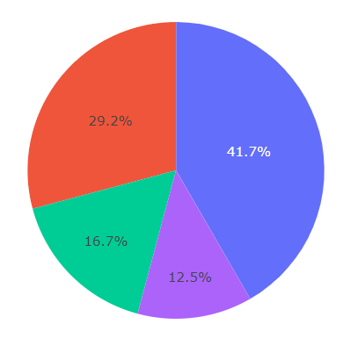
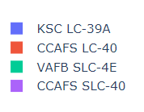
Build a Dashboard with Plotly Dash – cont’d
The dashboard makes it very easy to visualize information to allow quicker analysis than simply looking at the raw numbers behind the graphs.
For example, the two images below show the same information, but the pie chart makes it clear very quickly that the KSC LC-39A launch site has significantly more successful launches than the others.

Slide 27
Build a Dashboard with Plotly Dash – cont’d
GIT URL
https://github.com/mtravaglini/DataScienceCapstone/blob/master/spacex_dash_app.py

Slide 28
Predictive Analysis (Classification)
For the Predictive Analysis, we create a machine learning pipeline to predict if the first stage rocket will land given the data we acquired and wrangled from the SpaceX API
The first step is to load the collected/wrangled data into the dataframes. The first dataframe is created from the API data collected earlier, which we wrangled to add a class column which indicates success or failure of the launch. We create a list of the class values, and we use this as the Y data (i.e. the dataset target) for the analysis.
Based on the EDA, plotting, mapping, charting etc., we determine which of the other columns in the dataset are related to the launch outcome. These columns are transformed if required, for example several categorical columns are transformed to numeric/Boolean values using one-hot encoding. This data is then used as the X data (i.e., the features or independent variables) for the models.
The X data is then normalized using the preprocessing.StandardScaler() function. This is to get all the features on a similar scale and reduce the impact of outliers.
We then split the X and Y data into training and testing datasets. We use 80% of the data to train and 20% for testing.

Slide 29
Predictive Analysis (Classification) – cont’d
Next 4 different classification models are created:
logistic regression
support vector machine
decision tree classifier
K nearest neighbour
For each one, GridSearch is used to find the Hyperparameters that allow a given algorithm to perform best. Following is the code for doing the GridSearch for the Logistic Regression model, as an example:
parameters ={"C":[0.01,0.1,1],'penalty':['l2'], 'solver':['lbfgs']}# l1 lasso l2 ridge
lr=LogisticRegression()
gs_lr = GridSearchCV(lr, parameters,cv=10)
logreg_cv = gs_lr.fit(X_train, Y_train)
We can see the best hyperparameters chosen by GridSearch:
tuned hyperparameters :(best parameters) {'C': 0.01, 'penalty': 'l2', 'solver': 'lbfgs’}
We do this for each model (LR, SVM, Decision Tree and KNN). Using the best hyperparameter values for each, we then check the accuracy of each model using the training data. We then use the test data to test each model and plot the Confusion Matrix for each one.
Then we select the best performing model to use going forward.

Slide 30
Flowchart of the Predictive Analysis Pipeline
Collect Data
Wrangle Data
Exploratory Data Analysis
Pre-Processing
Train/Test Data Split
Create Models
GridSearch Each Model
Train Model
Test Model

Slide 31
Predictive Analysis (Classification) – cont’d
GIT URL
https://github.com/mtravaglini/DataScienceCapstone/blob/master/SpaceX_Machine%20Learning%20Prediction_Part_5.ipynb

Slide 32

Section 2

Slide 33
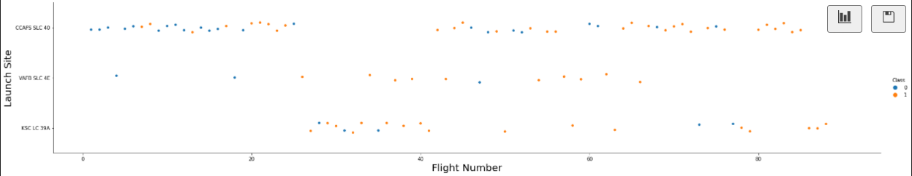
Insights Drawn from EDA
A chart is plotted showing FlightNumber vs. LaunchSite to see if the launch site had any effect on the success rate. We can easily get the success percent by launch site as follows:
df.groupby(by=['LaunchSite'])['Class'].mean() * 100
LaunchSite
CCAFS SLC 40 60.000000
KSC LC 39A 77.272727
VAFB SLC 4E 76.923077
Most of the launches are at CCAFS SLC 40, even though it has the lowest success percentage. Later launches (i.e., increasing flight numbers) are more frequently successful than earlier launches.

Slide 34
Insights Drawn from EDA – cont’d
The next chart plotted is PayloadMass vs. LaunchSite to see if there is any relationship between the two.
This shows that the VAFB-SLC launches have lighter payloads, all less than 10,000. For KSC LC 39A, most failures are around the 6,000kg mark and most of the others are successful. For CCAFS SLC 40, the successes and failures are fairly evenly spread except for the very heavy payloads, around 14-16,000kg, where most of them are successful.

Slide 35
Insights Drawn from EDA – cont’d
Next is a bar chart showing the percentage of successful launches by Orbit. We can calculate this with:
df.groupby(by=['Orbit'])['Class'].mean() * 100
Orbit
ES-L1 100.000000
GEO 100.000000
GTO 51.851852
HEO 100.000000
ISS 61.904762
LEO 71.428571
MEO 66.666667
PO 66.666667
SO 0.000000
SSO 100.000000
VLEO 85.714286
This shows that the ES-L1, GEO, HEO and SSO are 100% successful. The VLEO orbit is also good at 86%, and the rest are all in the 50-60% success range. the SO orbit is 0% successful, but if we look further at the data, this is only for 1 launch attempt so may not be indicative.

Slide 36
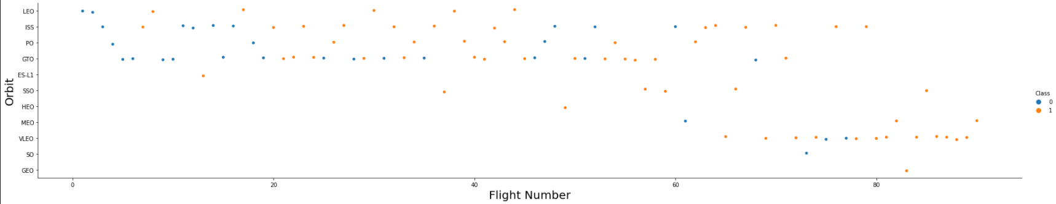
Insights Drawn from EDA – cont’d
Next is a scatter plot showing the relationship between FlightNumber and Orbit type.
For LEO and VLEO orbit the successes increase significantly with later flights. The 100% successful ones (ES-L1, GEO, HEO and SSO) all have relatively fewer launches. The SO orbit has just a single launch. The remaining orbits seem to fluctuate between failure and successes.

Slide 37
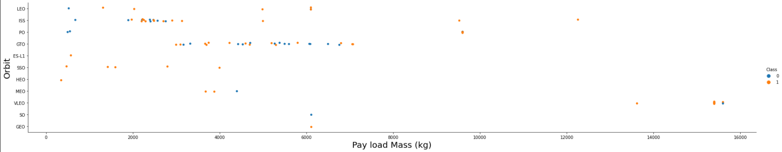
Insights Drawn from EDA – cont’d
Next is a scatter plot showing the relationship between PayloadMass and Orbit type.
With heavy payloads over 9,000kg, they are successful with the exception of one VLEO orbit launch.
The lighter payloads are mainly successful with the exception of ISS, PO and GTO which have several failures mixed in with the successes.

Slide 38
Insights Drawn from EDA – cont’d
Next, we look at the yearly trend of the launch success rate trend.
We can see the success rate increase steadily from 2013, but with smaller drops in 2018 and 2020.

Slide 39
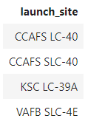
All Launch Site Names
Find the names of the unique launch sites
SELECT distinct(launch_site)
FROM SPACEXTBL;
Use the distinct keyword to return unique names only (i.e., no repeating values in the result set)

Slide 40
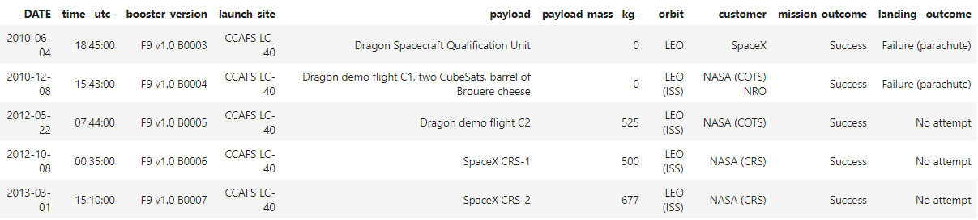
Launch Site Names Begin with 'CCA'
Find 5 records where launch sites begin with `CCA`
SELECT *
FROM SPACEXTBL
WHERE launch_site like 'CCA%'
LIMIT 5;
Use the limit keyword with a value of 5 to limit the result set to the first 5 rows retrieved. Use the like keyword, with the % wildcard in the where clause to get all rows with the launch site name beginning with CCA.

Slide 41
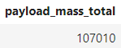
Total Payload Mass
Calculate the total payload carried by boosters from NASA
SELECT SUM(payload_mass__kg_) AS payload_mass_total
FROM SPACEXTBL
WHERE customer like '%NASA%';
Use the sum keyword to calculate the total sum of the column payload_mass__kg_. Select all rows with the text NASA anywhere in the customer column by using the like clause and % wildcard on either side of NASA text in the where clause.

Slide 42
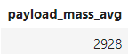
Average Payload Mass by F9 v1.1
Calculate the average payload mass carried by booster version F9 v1.1
SELECT AVG(payload_mass__kg_) AS payload_mass_avg
FROM SPACEXTBL
WHERE booster_version = 'F9 v1.1’;
Use the avg keyword to calculate the average of the column payload_mass__kg_. Select all rows with the booster_version of “F9 v1.1” as specified in the where clause.

Slide 43
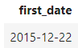
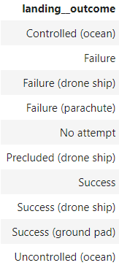
First Successful Ground Landing Date
Find the dates of the first successful landing outcome on ground pad
SELECT MIN(date) AS first_date
FROM SPACEXTBL
WHERE landing__outcome = 'Success (ground pad)’;
** Note that a query was necessary before this one to retrieve the value to use in the where clause:
select distinct(landing__outcome) from SPACEXTBL;
Use the min keyword to retrieve the minimum, or earliest, date value. Select all rows with the landing_outcome of “Success (ground pad)” as specified in the where clause.

Slide 44
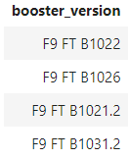
Successful Drone Ship Landing with Payload between 4000kg and 6000kg
List the names of boosters which have successfully landed on drone ship and had payload mass greater than 4000 but less than 6000
SELECT booster_version
FROM SPACEXTBL
WHERE landing__outcome = 'Success (drone ship)'
AND payload_mass__kg_ > 4000
AND payload_mass__kg_ < 6000;
Select all booster_version values with the landing_outcome of “Success (drone ship)” as specified in the where clause. Also in the where clause, limit the payload_mass__kg_ to above 4000 and below 6000. Note that the requirement is not inclusive (i.e., don’t include 4000 and 6000 values in the results). If it were, then “payload_mass__kg_ between 4000 AND 6000” could have been used.

Slide 45
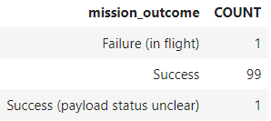
Total Number of Successful and Failure Mission Outcomes
Calculate the total number of successful and failure mission outcomes
SELECT mission_outcome
,COUNT(*) AS count
FROM SPACEXTBL
GROUP BY mission_outcome;
Use the count keyword to count the rows per distinct value of the mission_outcome column, as specified by the group by clause.

Slide 46
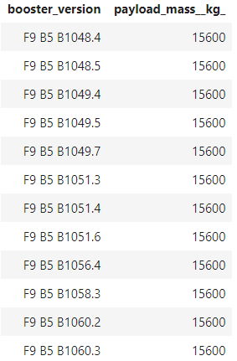
Boosters Carried Maximum Payload
List the names of the booster which have carried the maximum payload mass
SELECT distinct booster_version, payload_mass__kg_
FROM SPACEXTBL
WHERE payload_mass__kg_ =
(SELECT MAX(payload_mass__kg_)
FROM SPACEXTBL);
For this task, use a subquery to return the maximum payload mass, using the max function. The main query then returns all the rows where the payload_mass__kg_ equals the maximum returned by the subquery. List the booster_version values and the payload_mass_kg_ values. Use the distinct keyword to not return any duplicate rows, in the case where the same booster version carried the exact maximum payload more than once.

Slide 47
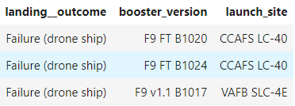
2015 Launch Records
List the failed landing_outcomes in drone ship, their booster versions, and launch site names for in year 2015
SELECT distinct landing__outcome, booster_version, launch_site
FROM SPACEXTBL
WHERE year(date) > 2015
AND landing__outcome = 'Failure (drone ship)’;
Select all rows from the year 2015, using the year function in the where clause which returns just the year portion of a date value. Also in the where clause, select only rows with a landing__outcome of “Failure (drone ship)”. Use the distinct keyword to not return any duplicate results.

Slide 48
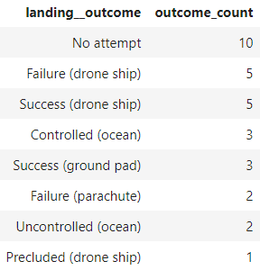
Rank Landing Outcomes Between 2010-06-04 and 2017-03-20
Rank the count of landing outcomes (such as Failure (drone ship) or Success (ground pad)) between the date 2010-06-04 and 2017-03-20, in descending order
SELECT landing__outcome, COUNT(*) AS outcome_count
FROM SPACEXTBL
WHERE DATE BETWEEN '2010-06-04' AND '2017-03-20'
GROUP BY landing__outcome
ORDER BY outcome_count desc;
Use the count keyword to count the rows per distinct value of the landing_outcome column, as specified by the group by clause. Select only those rows with the requested dates from 2010-06-04 to 2017-03-20 inclusive, using the between option in the where clause. To return the rows in descending order by the count, use the order by clause with the outcome_count value and specify the desc option.

Slide 49

Section 3

Slide 50
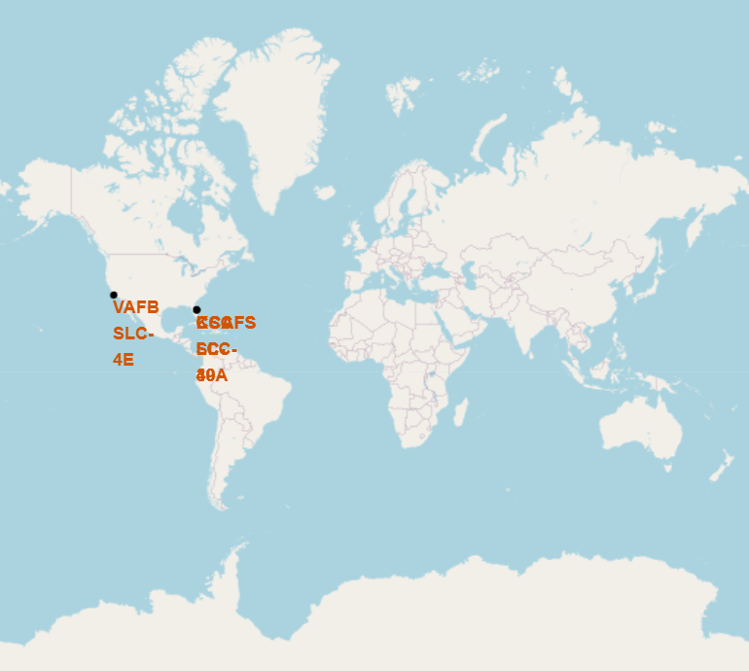
Map – All Launch Sites
We can start with a view of the map of the world, and see the sites are in the USA:

Slide 51
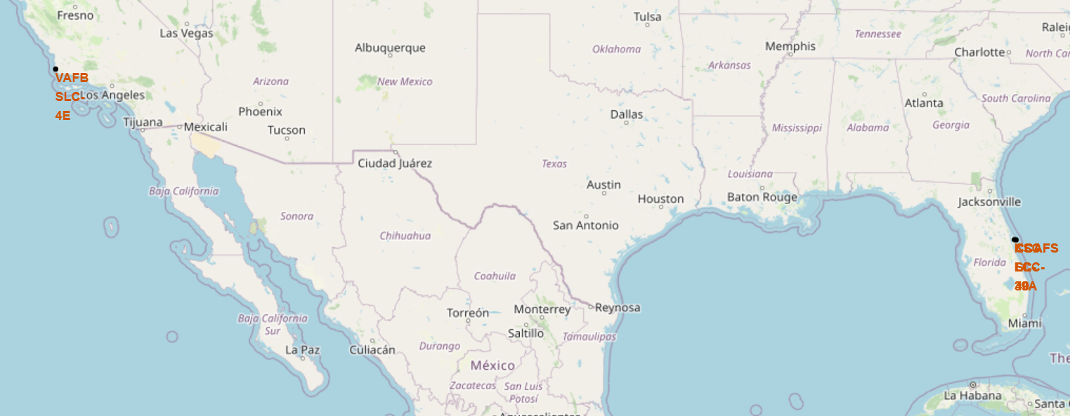
Map – All Launch Sites – cont’d
Zooming in, we can see all the launch sites which are concentrated on the south-eastern and south-western coasts of the USA:

Slide 52
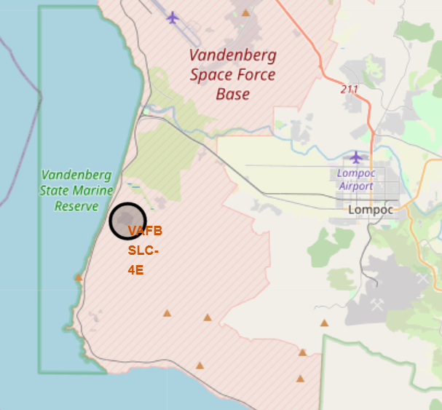
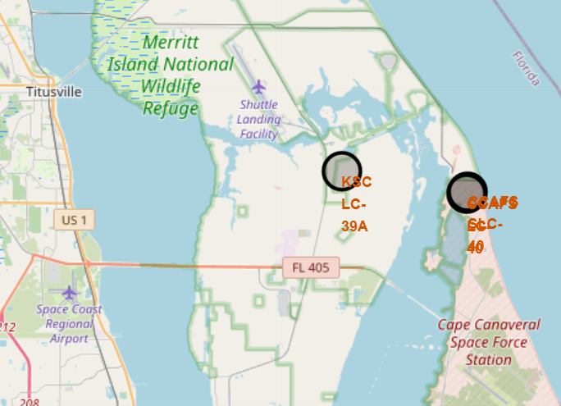
Map – All Launch Sites – cont’d
Zooming in on both coasts, we see a more detailed picture of the launch site locations. These maps show that the launch sites are in the USA and close to the oceans. This is likely to allow landings (successful or otherwise) in the relative safety of the ocean and away from the built-up or populated areas on land. There are 4 launch sites, one in California and the other 3 in Florida.

Slide 53
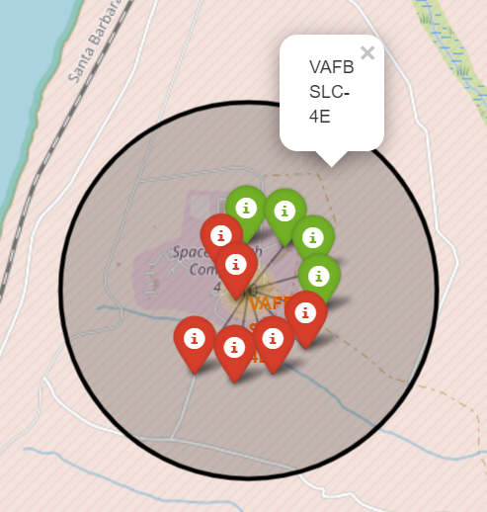
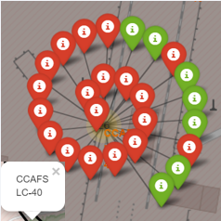
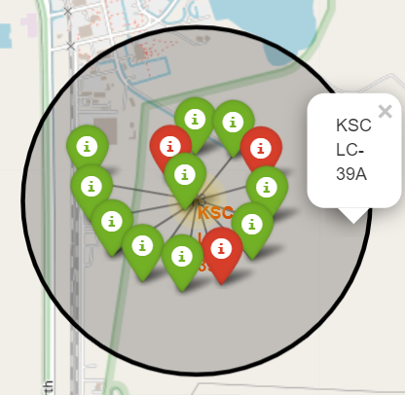
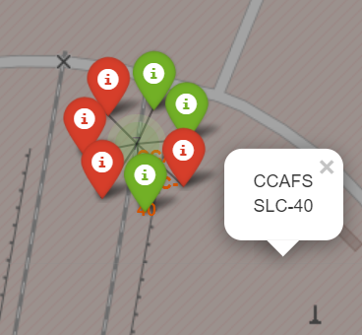
Map – Launch Outcomes
We can see the launch outcomes of the 4 launch sites.
red are failures
green are successes
We can see that CCAFS LC-40 had the most launches, many of which failed.
VAFB SLC-4E and CCAFS SLC-40 had relatively few launches balanced almost evenly between successes and failures.
The real “winner” is launch site KSC LC-39A with several launches and only 3 failures.

Slide 54
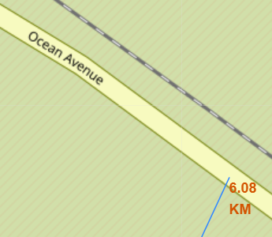
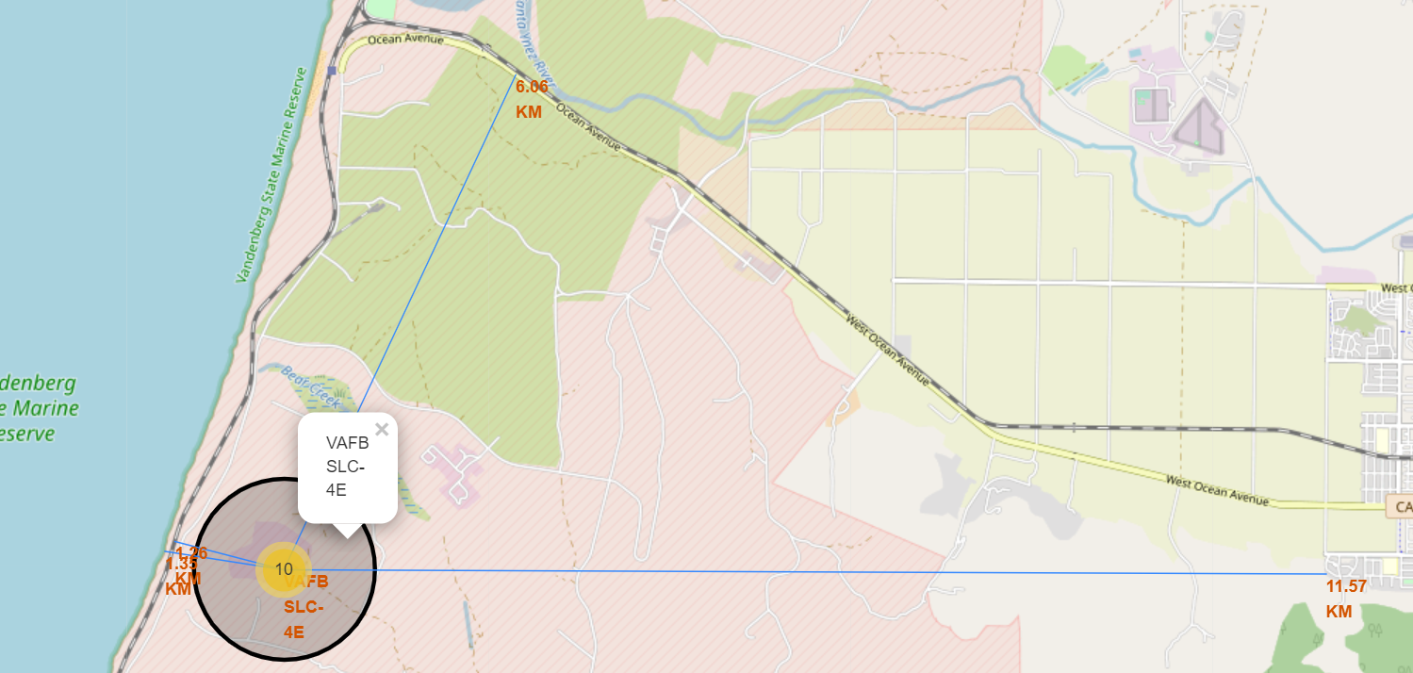
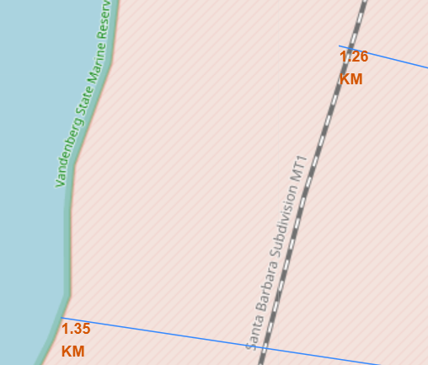
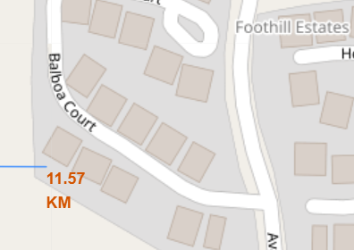
Map – Launch Site Proximity to Objects
HIGHWAY
RAILWAY
CITY
COASTLINE
This is a map of one site, but all the launch sites are similar. They are nearer to the coastlines (for safety) and railways (likely for transportation requirements).
They are further away from highways and cities. This is likely for safety and perhaps to reduce noise pollution, by keeping rocket launches away from populated areas.

Slide 55

Section 4

Slide 56
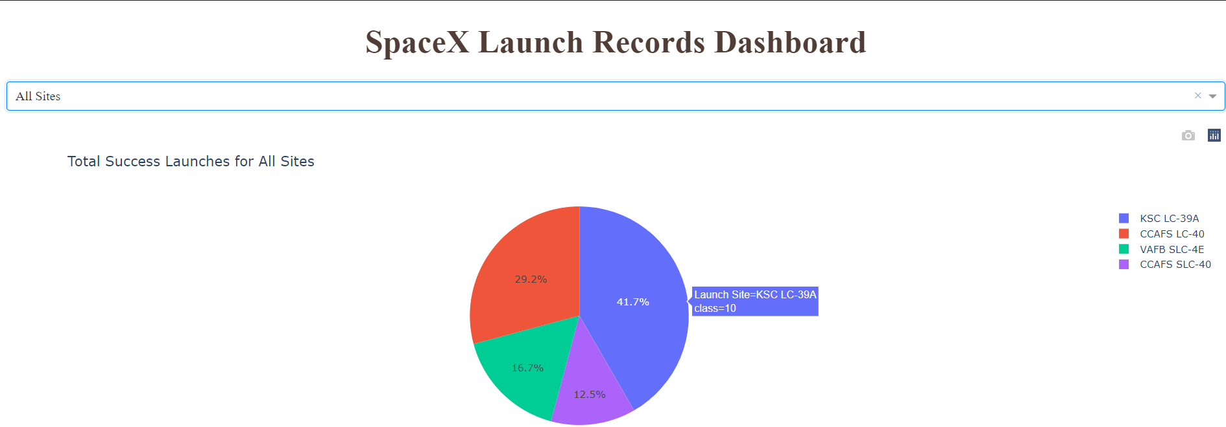
Pie Chart – Success % for All Launch Sites
This chart shows that 41.7% of all the successful launches are from the KSC LC-39A site. The CCAFS LC-40 site has a good share of the success at 29.2%, and the other two sites have fewer at 16.7% and 12.5%.

Slide 57
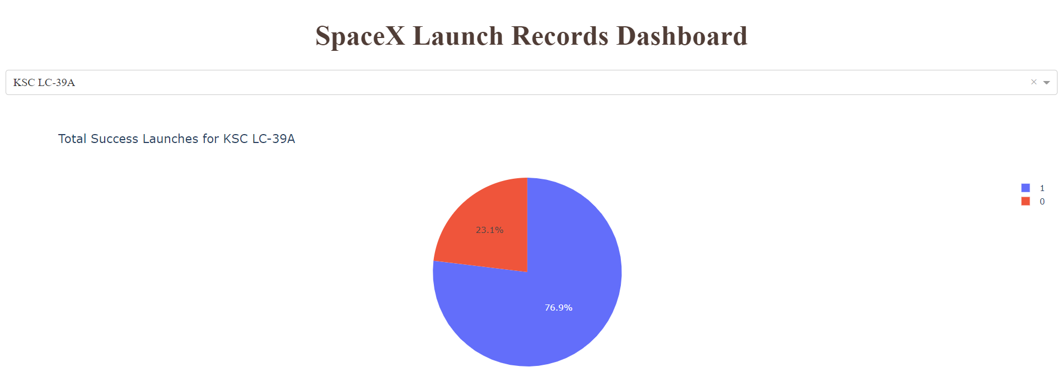
Pie Chart – Launch Site with Highest Success Rate
The following shows that 76.9% of launches were successful and 23.1% failed from the KSC LC-39A site.

Slide 58
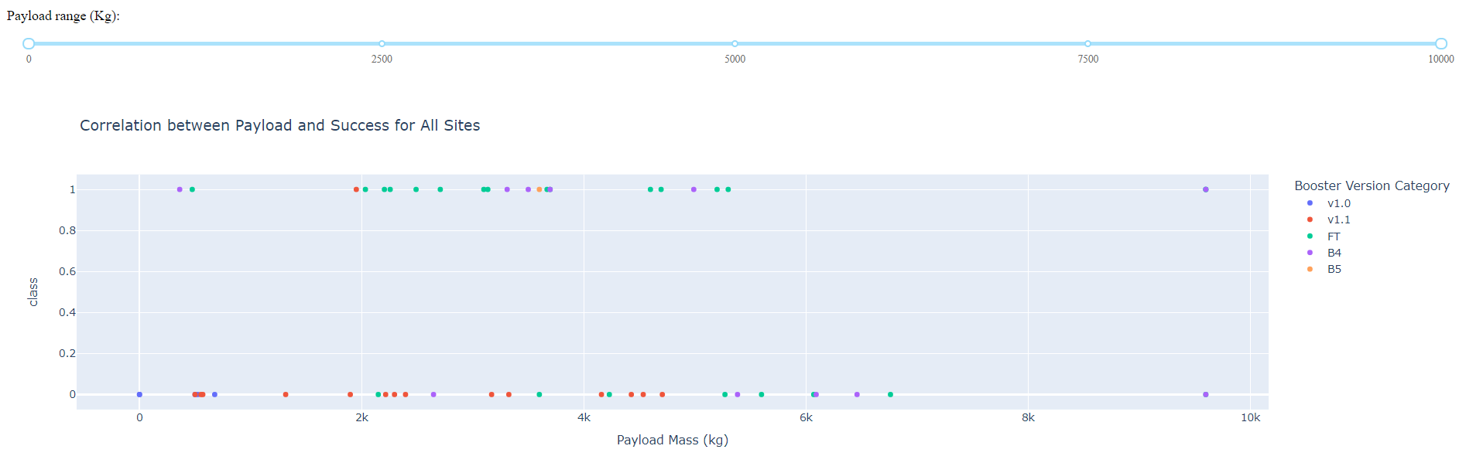
Scatter Plot – Payload vs Launch Outcome
This graph includes all launch sites and all payloads.
The successful launches (i.e., class = 1) seem to be clustered between just under 2,000kg and under 4,000kg. We can use the range slider to select this range.

Slide 59
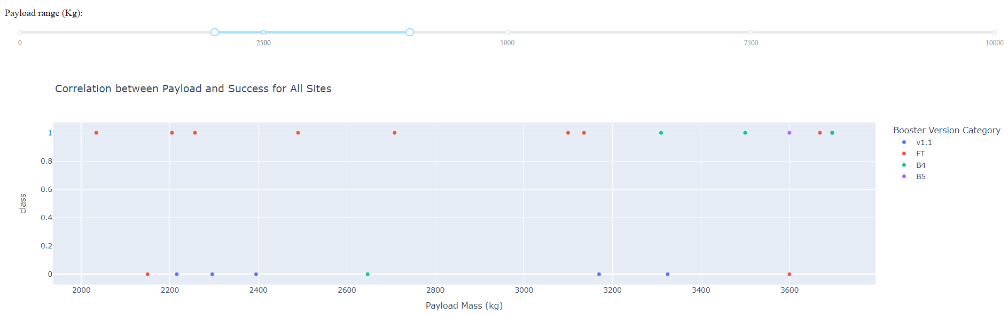
Scatter Plot – Payload vs Launch Outcome – cont’d
This graph includes all launch sites and payloads between 1,950kg and 4,000kg.
This is where most of the successful launches (i.e., class = 1) are clustered. The chart shows that most of the successful launches use the FT booster version.

Slide 60

Section 5

Slide 61
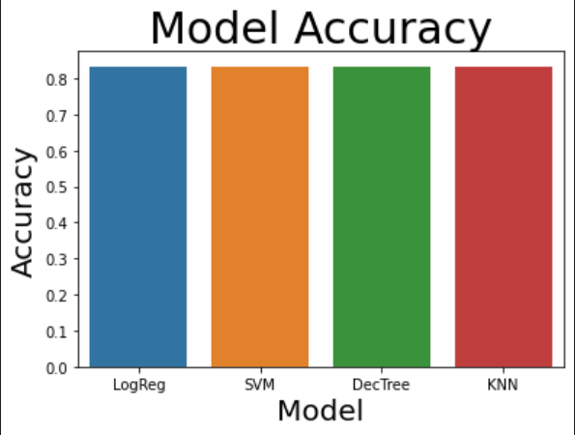
Classification Accuracy
All 4 classification models perform the same. The accuracy scores are exactly the same for all four tests.

Slide 62
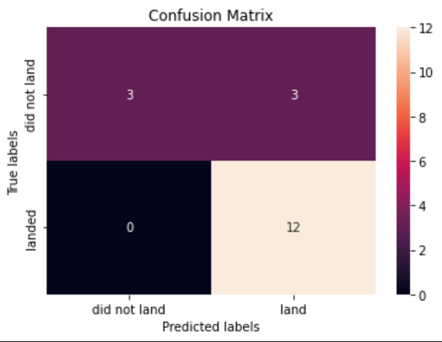
Confusion Matrix
The confusion matrix is identical for all four classification models.
The matrix shows 15 correct predictions out of 18. The 3 incorrect predictions are false positives shown in the upper-right quadrant. That is, there were 3 predictions for a successful landing that actually ended in failure. There were no false negatives.

Slide 63
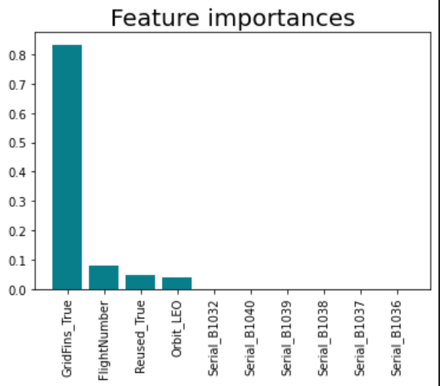
Conclusions
1) During the Exploratory Data Analysis (EDA) several relationships between the independent variables and launch results were discovered. Using various techniques such as mapping, scatter plots, pie charts, SQL queries, etc. we decided which features to use in the models. However, more work that is outside the scope of this project is probably required to determine the importance of the features/independent variables.
For example, on the Decision Tree model, the importance of the features is retrieved using this code:
tree_gs.best_estimator_.feature_importances_
Using these values, we can plot the features sorted by their importance. As we can see, only the first 4 features are important, and the rest have zero importance.
We could do this for the different models to make the pipeline more efficient by eliminating unimportant columns from the data.

Slide 64
Conclusions – cont’d
2) The EDA allowed us to understand commonalities in launches, for example, the launch sites are closer to oceans and transportation (rail), but further from built up areas like cities and highways.
3) Four different models were trained/tested (Logistic Regression, SVM, Decision Tree and KNN), they all had the same results, that is, the same accuracy and confusion matrices.
4) We can predict the outcome of future launches with 83% accuracy.

Slide 65
Appendix 1 – Input/Output Datasets
1) jupyter-labs-spacex-data-collection-api.ipynb
in: https://api.spacexdata.com/v4/launches/<xxx>
out: dataset_part_1.csv
2) jupyter-labs-webscraping.ipynb
in: https://en.wikipedia.org/w/index.php?title=List_of_Falcon_9_and_Falcon_Heavy_launches&oldid=1027686922
out: spacex_web_scraped.csv
3) labs-jupyter-spacex-Data wrangling.ipynb
in: https://cf-courses-data.s3.us.cloud-object-storage.appdomain.cloud/IBM-DS0321EN-SkillsNetwork/datasets/dataset_part_1.csv
out: dataset_part_2.csv (add class column)
4) jupyter-labs-eda-dataviz.ipynb
in: # https://cf-courses-data.s3.us.cloud-object-storage.appdomain.cloud/IBM-DS0321EN-SkillsNetwork/datasets/dataset_part_2.csv
in: https://cf-courses-data.s3.us.cloud-object-storage.appdomain.cloud/IBMDeveloperSkillsNetwork-DS0701EN-SkillsNetwork/api/dataset_part_2.csv
out: dataset_part_3.csv (one-hot features)
5) jupyter-labs-eda-sql-coursera.ipynb
in: https://cf-courses-data.s3.us.cloud-object-storage.appdomain.cloud/IBM-DS0321EN-SkillsNetwork/labs/module_2/data/Spacex.csv
out: SPACEXTBL (DB2 database table)

Slide 66
Appendix 1 – Input/Output Datasets cont’d
6) lab_jupyter_launch_site_location.ipynb
in: https://cf-courses-data.s3.us.cloud-object-storage.appdomain.cloud/IBM-DS0321EN-SkillsNetwork/datasets/spacex_launch_geo.csv
out: n/a
7) lab_jupyter_launch_site_location.ipynb
in: https://cf-courses-data.s3.us.cloud-object-storage.appdomain.cloud/IBM-DS0321EN-SkillsNetwork/datasets/spacex_launch_dash.csv
out: n/a
8) spacex_dash_app.py
in: https://cf-courses-data.s3.us.cloud-object-storage.appdomain.cloud/IBM-DS0321EN-SkillsNetwork/datasets/spacex_launch_dash.csv
out: n/a
9) SpaceX_Machine Learning Prediction_Part_5.ipynb
in: https://cf-courses-data.s3.us.cloud-object-storage.appdomain.cloud/IBM-DS0321EN-SkillsNetwork/datasets/dataset_part_2.csv
in: https://cf-courses-data.s3.us.cloud-object-storage.appdomain.cloud/IBMDeveloperSkillsNetwork-DS0701EN-SkillsNetwork/api/dataset_part_2.csv
https://cf-courses-data.s3.us.cloud-object-storage.appdomain.cloud/IBM-DS0321EN-SkillsNetwork/datasets/dataset_part_3.csv
https://cf-courses-data.s3.us.cloud-object-storage.appdomain.cloud/IBMDeveloperSkillsNetwork-DS0701EN-SkillsNetwork/api/dataset_part_3.csv
out: n/a

Slide 67


